Slide 1
Unmanned Aerial Vehicle

Slide 2
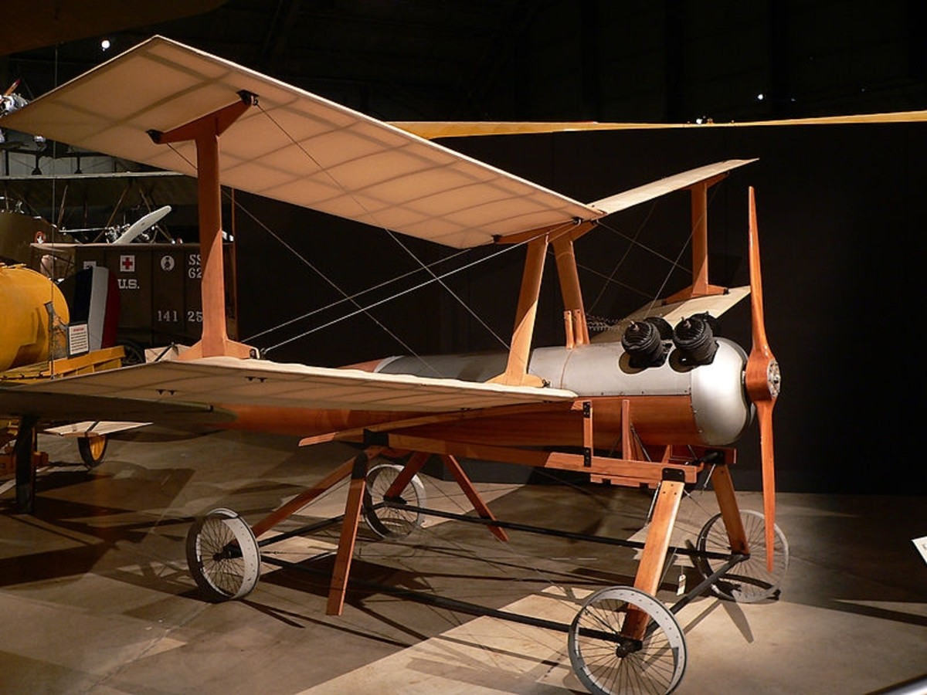
Introduction
Historical Background
The earliest recorded use of an unmanned aerial vehicle for warfighting occurred in July 1849, serving as a balloon carrier in the first offensive use of air power in naval aviation. Austrian forces besieging Venice attempted to launch some 200 incendiary balloons at the besieged city.
UAV innovations started in the early 1900s, and originally focused on providing practice targets for training military personnel. UAV development continued during World War I, when the Dayton-Wright Airplane Company invented a pilotless aerial torpedo that would explode at a preset time.

Slide 3
Overview
#1 Physical Design for various applications
#2 Propulsion System and Actuators
#3 Navigation System and Control
#4 Data Transmission
#5 Data Collection
#6 Power Management System

Slide 4
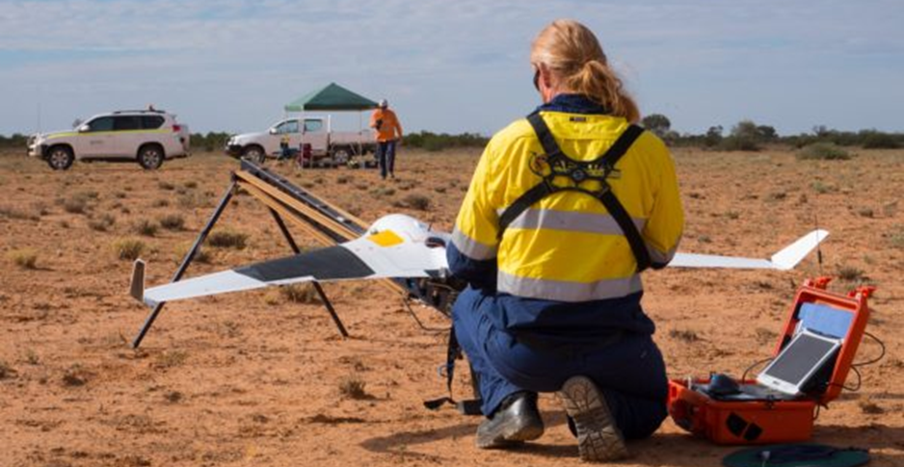
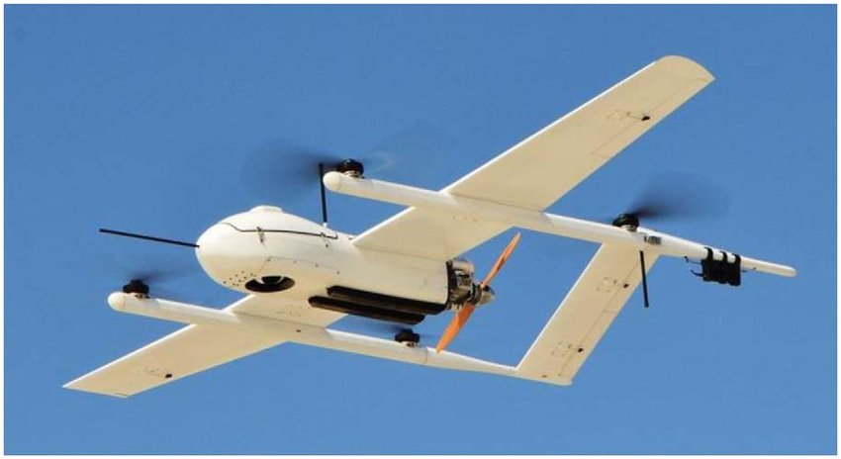
Physical Design for Various Applications
There are many types of UAV used worldwide today, such as:
Fixed-wing: use a wing like a normal plane to provide lift rather than vertical lift rotors. Because of this they only need to use energy to move forward.
Multi-rotor: most widely used UAV today due to the ease to control and the cheap price.
Blimp: uses a large balloon containing helium and some weight to maintain its buoyancy aerially.
Hybrid VTOL: merging fixed-wing design with ability to hover, this hybrid can take off and land vertically.

Slide 5
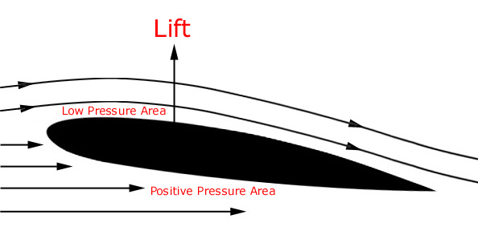
Propulsion System and Actuators
Understanding multi-rotor and fixed-wing UAV propulsion system:
UAV uses blades/wings with airfoil technology to produce lift that is higher than exceeds the weight to move. The greater the blade speed, the greater the lift force.
Multi-rotor drones must place the blades symmetrically from the Centre of Gravity to ensure stability.
When lift reduced to weight, the drone can hover around.
To turn the drone at any axis (x, y and z), the rotor speed must be changed based on diagonal, vertical or horizontal pairs.
Drones nowadays use Brushless DC Motor for high efficiency and excellent controllability.
For fixed-wing, it needs servos to control ailerons, rudders and elevators for rotation in pitch, roll and yaw direction.

Slide 6
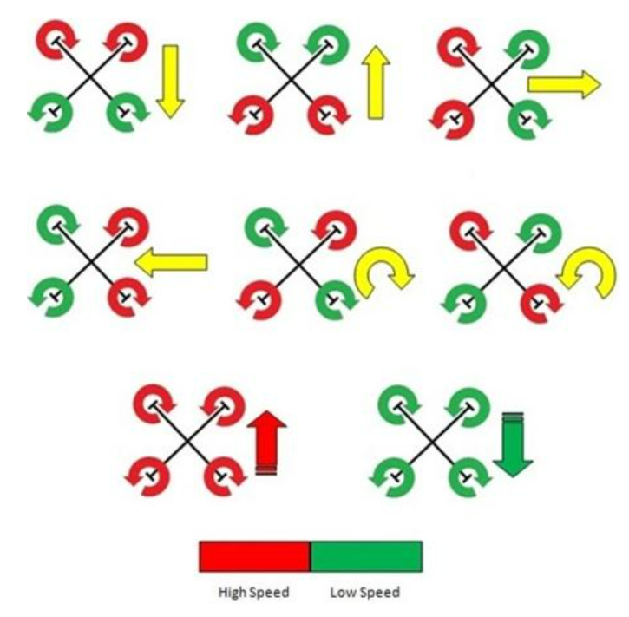
Multi-rotor Drone Propulsion System

Slide 7
Navigation System and Control
UAV requires navigation system to go from one place to another. Control system is needed to avoid obstacles and maintain its stability.
Manually, UAV can be controlled by via a remote control. During autopilot missions, it is controlled through a software by following the speed.
Accelerometer and gyroscope are used to control stability and position manually especially when under windy conditions. For autonomous system, UAVs may use GPS or SLAM technology.
Pixhawk Flight Controller is used as the core of the navigation and control system. If orientation of the UAV is disturbed, it will be return to offset position using a sensor.

Slide 8
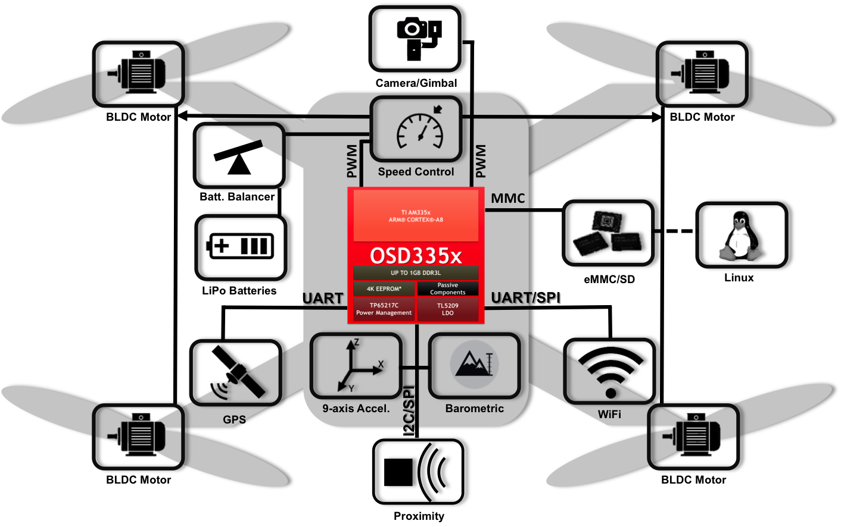
Controller System

Slide 9
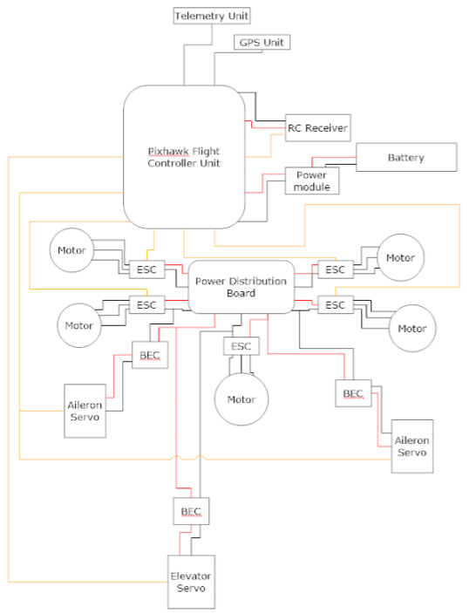
Data Transmission and Acquisition
Data is transmitted from the transmitter Remote Control at the ground to receive remote control on the VTOL-UAV by microwave signal operating at 2.4Ghz.
Other data transmitter from the ground is the controlling and navigation direction info for the UAV (setting home etc).
RC receiver receives data and channels it to the Pixhawk Flight Controller to control the rotation or RPM of the motor during takeoff, landing or horizontal movement.
ArduPilot Mission Planner used for autopilot mission.
The DJI systems use 2.4Ghz for UAV control and 5Ghz for video transmission. This setup will give the user approximately 4 miles of range.
Accelerometer and gyroscope detects the position and orientation of the UAV.
Gimbals are used to stabilize camera payloads that have been mounted on drones.

Slide 10
Obstacle Avoidance
Usual UAVs use ultrasonic sensors to avoid obstacles automatically.
Manually, we can also move the drone to avoid obstacles with HD camera or thermal camera.
FlightAutonomy Technology is Mavic Pro’s new brain and nervous system, a complex network of hardware and software consisting of five cameras, GPS and GLONASS navigation systems, a pair of ultrasonic range finders, redundant sensors and 24 powerful computing cores to avoid obstacles in any environment.
SLAM technology is another intelligent obstacle avoidance sensor option to choose from.
All the options above depends on the purpose of the drone you plan to design and the budget you have.

Slide 11
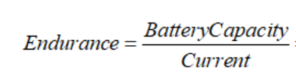
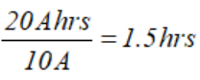
Power Management System
It is dependent on the purpose and design of your drone.
Fixed-wing: has great endurance. The battery used in this specific UAV is a 14.8v Lithium Polymer (Li-Po) 20Ah battery. This UAV has a “cruising current” of 10 Amps.
Multi-rotor: With current battery technology they are limited to around 20-30 minutes when carrying a lightweight camera payload. Heavy-lift multi-rotors are capable of carrying more weight, but in exchange for much shorter flight times. We use similar battery but this model uses higher current.

Slide 12
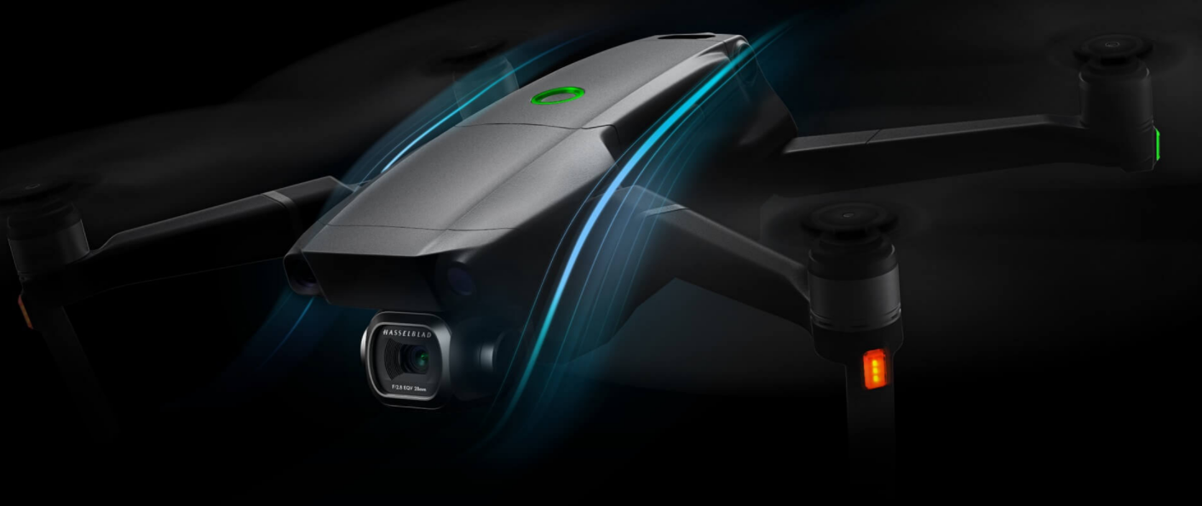
UAVs Today!
The Mavic 2 has been optimally redesigned to increase propulsion, lower power consumption, and reduce noise. These subtle yet powerful improvements, along with an improved FlightAutonomy system, offer a smoother, quieter flight for greater discretion and safety with fantastic camera resolution!

Slide 13
Hardware
ITEMS | LINK
14.8v Lipo 20Ah Battery | https://www.batteryspace.com/polymer-li-ion-rechargeable-battery-pack-14-8v-20ah-296-wh-----un38-3-passed.aspx
Propeller blades | https://store.dji.com/product/dji-fpv-propellers
Remote Controller | https://store.dji.com/product/cendence-remote-controller
Camera with gimbal | https://store.dji.com/product/dji-fpv-gimbal-camera?from=search-result-v2&position=13
Pixhawk 4 flight controller | https://www.sparkfun.com/products/14841

Slide 14
Hardware #2
ITEMS | LINK
Matek Power Distribution Board | https://sea.banggood.com/Matek-FCHUB-6S-Hub-Power-Distribution-Board
Electronic Speed Controller (4 in 1) | https://sea.banggood.com/AIKON-AK32-4-IN-1-35A-2-6S-Blheli_32-DSHOT1200-Brushless-ESC-W-5V3A-BEC-for-RC-Drone-FPV-Racing
Brushless DC Motor | https://sea.banggood.com/BrotherHobby-Avenger-2806
Camera with gimbal | https://my.cytron.io/p-high-resolution-ultrasonic-range-finder?r=1&gclid=Cj0KCQjw38-DBhDpARIsADJ3kjlU91I_22wKVU6EFG-AaEB3vdOCGAHMtSlB7CqBxPQHWjw9PdHDG3QaAjfzEALw_wcB

Slide 15
THANK YOU!
KHAIRYL MUADZ BIN ROSLAN

